Slide 1
Graph Classification Task: Preprocessing on ADNI and AD datasets
Yikang Li 2022/5/22

Slide 2

Overview
Binary graph classification Tasks
ADNI dataset - Patients/Controls classes. Node: 90, Amount: 218
AD dataset - AD/CN classes. Node: 90. Amout: 202
Finished testing the performance of 10 GNN based models on two datasets with different preprocessing methods
Tested the performance of Spatial Graph Convolutional Network

Slide 3
Model Evaluation on ADNI Dataset
1. BrainNet CNN always perform better compare to other existed GNN.
2. Taking node strength as the node feature is better than taking 1 or degree as the node feature.
3. However, changing the preprocessing method does not make the GNN better than BrainNet CNN.

Slide 4
Model Evaluation on CNI Dataset
1. The degree of CNI is always 116 since it is a fully connected graph.
2. Taking node strength as the node feature is better than taking 1 or degree as the node feature.
3. However, changing the preprocessing method does not make the GNN better than BrainNet CNN.
4. Although using the node strength as the node feature increases the accuracy, the performance is till too bad for graph classification tasks.

Slide 5
Model Evaluation on AD Dataset
1. BrainNet CNN always perform better compare to other existed GNN.
2. Taking degree as the node feature is best preprocessing method for AD dataset.
3. However, changing the preprocessing method does not make the GNN better than BrainNet CNN.

Slide 6
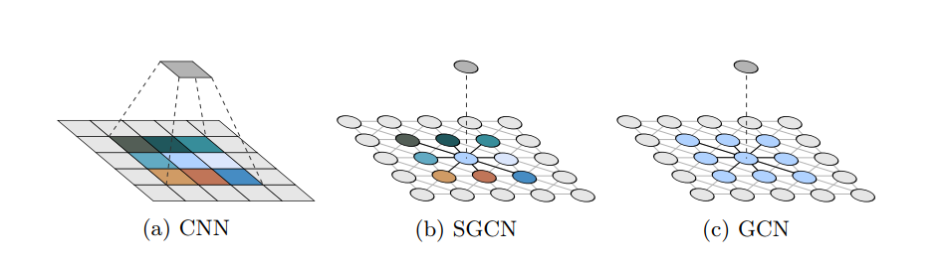
Spatial Graph Convolutional Network:
01 | Comparing to the classical GCN, spatial GCN can effectively extract the geometric/spatial features of graphs by utilizing the node positions.
02 | Spatial GCN is a proper generalization of GCN and CNN, which conbines the advances of GCN and CNN.
03 | It effectively increases the precision on graph classification tasks for super pixel MNIST dataset.
04 | Data Augmentation methods such as node ordering, rotation and translations can be utilized since the spatial GCN can extract the selective invariance of spatial properties.

Slide 7
Results of Spatial GCN on different datasets
1. Spatial GCN does not performs better on two different datasets compared to existed GNN.
2. The possible issue might happen at the data manipulation processing. The data used in paper is a 2D MNIST dataset which contains 2D node position. However, our data is 3D which contains 3D node position.

Slide 8
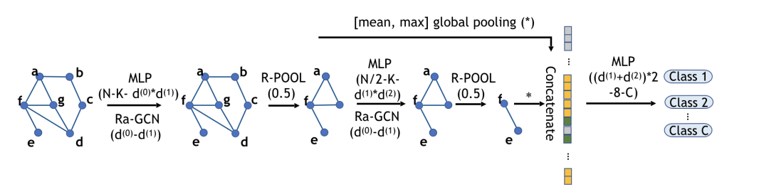
Brain GNN:
1. The Brain GNN architecture composed of Ra-GNN and R-pool blocks.
2. The Ra-GNN block will embed the node features and aggregate these features from different communities. Finally it updates node representations.
3. The R-pool block will project all node representations to a learnable vector. The nodes with large projected values are retained with their correspoding connections.

Slide 9
Future Work
01 | Testing the performance of Brain GNN on different datasets.
02 | Combining the spatial GCN with Brain GNN.
03 | Testing more graph preprocessing methods on different datasets.
04 | Node coordinate + Degree. 4D Node feature.

Slide 10
Thank you.

